Slide 1
Final Presentation
TEAM D
Final Presentation
★
Notes:
hello, my name is nayoung choi, of team D.
now, I will present the final presentation on the program about social development learning for autistic children.

Slide 2
CONTENTS
★
Objective and motivation
Final design
Final implementation – demo
AI - Model description
AI - Dataset
AI - Main hyperparameters
Challenges
Limitation
Evaluation
Notes:
This is a list of contents to be presented soon.

Slide 3
Objective and Motivation
★
Number of Autism Diagnosis: 8 times↑ Over 20 Years
Children subject to special education: 46.5%↑from 2018 to 2022 (5630 -> 8248)
Number of special teachers in 2023: 64.0%↓(292 -> 105)
Lack of institutions and welfare centers
→Need learning assistance program with high accessibility
Notes:
Let’s start with our objective and motivation.
Over the past 20 years, the diagnosis of autism spectrum disorders has increased about eightfold.
According to the research results, From 2018 to 2022, the number of autistic children in need of special education has risen by 46.5%.
However, as of 2023, the number of new teachers capable of instructing these special classes has actually decreased by 64% compared to the previous year.
The current institutions and welfare centers for autistic children are not enough to care all of these children, it requires money and time to provide appropriate learning programs for them.
In this situation, we need for an accessible learning assistance program for autistic children.

Slide 4
Objective and Motivation
★
Development of a learning assistance program for autistic children
Application of traditional emotion learning methods: PECS
By using computer vision technology
Users follow the facial expressions of various emotional videos
→Emotional recognition by Yolo: Learning correct facial expression
Notes:
The primary objective of the program is to provide an accessible learning aid program for children with autism.
To achieve this, we intend to employ the PECS method, a proven technique for teaching emotion recognition to autistic children. The traditional PECS approach uses emotional 'photo cards' to help children in understanding various emotional concepts. By adapting this, we present on-screen videos of virtual humans expressing a various emotions.
Children can see these videos and follow the expressions.
Subsequently, our program analyzes the child's emotions through YOLO, helping correct emotional learning.
Through this program, we can support children's learning process, significantly reducing the need for a parents’ assistance.
Moreover, it allows children to learn at any time and anywhere, only with a computer, free from constraints of time and place.

Slide 5
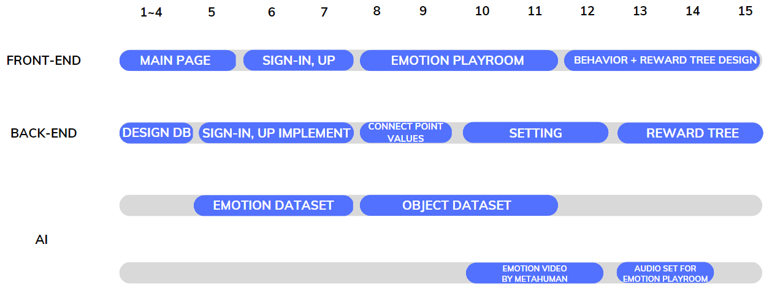
Project Progress
★
Notes:
Next, I would like to discuss the progress of our project.
On the frontend, we started with the main page, implemented the sign-up and sign-in pages, followed by the development of our core components: 감정놀이방, 행동놀이방, and 칭찬나무방
On the backend, we started by designing the database. Subsequently, we implemented the registration and login features, and connected the point acquisition feature based on activities in each playroom.
We added an option for users to customize snacks and completed the 칭찬나무 page.
In terms of AI, our focus was on collecting and training emotion datasets and object datasets. We also created emotion videos for use in the emotion playroom and produced audio guidance.

Slide 6
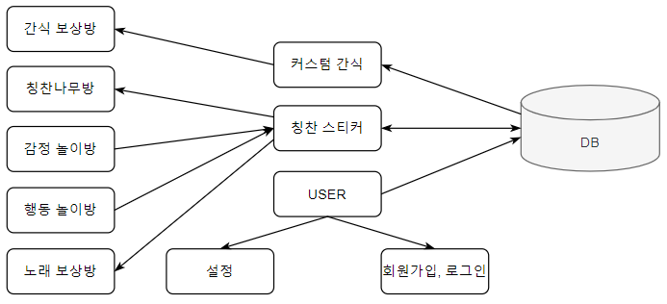
Final Design - Overall Architecture
★
Notes:
This shows our overall architecture.
When a user signs up or logs in from the login page, the main page appears. On the main page, there are ‘감정놀이방’, ‘행동놀이방’, ‘칭찬나무방’, ‘노래보상방’, ‘간식보상방’. 감정놀이방 and 행동놀이방 are ASD treatment programs using facial expressions and object recognition using AI models.
After taking quizzes about facial expressions and objects, evaluate whether user performed them correctly by showing the expressions or objects directly to the webcam.
칭찬나무방 provides the ability to get compliment stickers through learning, and user can exchange compliment stickers and rewards for user’s favorite character songs, videos, or real snacks through 노래보상방 and 간식보상방.
We are going to show you one by one.

Slide 7
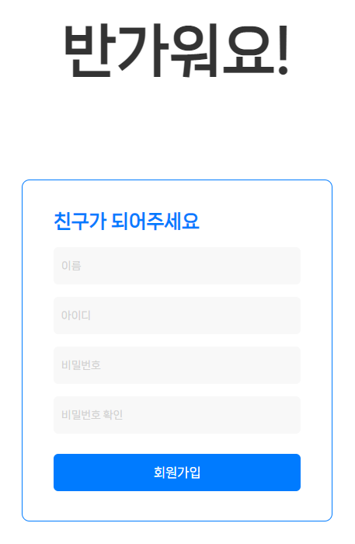
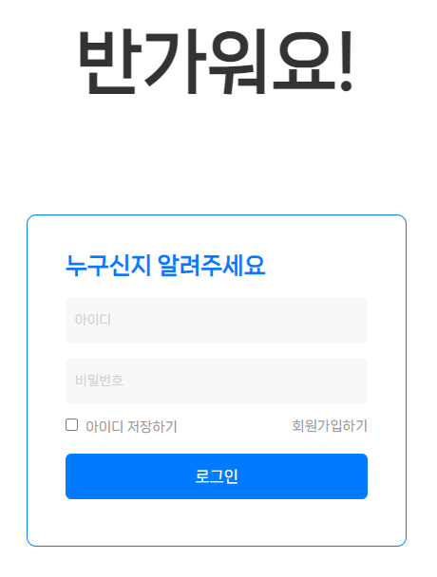
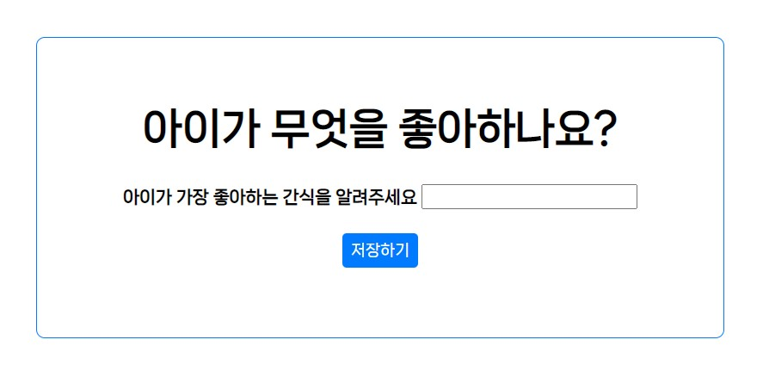
Final Design
★
Notes:
The final design of the frontend is like this.
The most important aspects we considered in frontend design were intuitiveness and easy to use.
We used large icons and fonts to ensure that users could easily understand and utilize the pages.
Also, we used a simple overall color scheme sky blue as the point color, which represents World Autism Awareness Day.
The pages you are seeing now, are the login, signup, and setting pages.
Once users successfully complete the login process, they are directed to the main page.

Slide 8
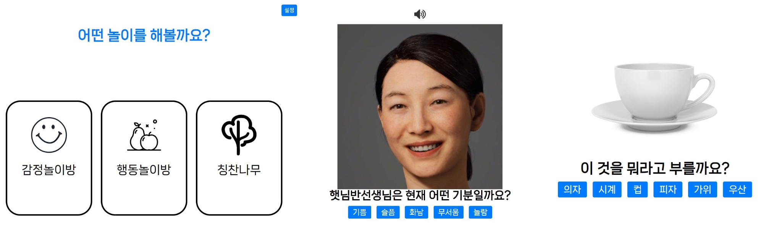
Final Design
★
Notes:
The page on the left is the main page of our project.
On the main page, there is a button on the upper right that leads to the settings page, and there are cards that can take you to three different pages.
When you click on the 감정놀이방 card, you will be taken to the page in the middle.
On this page, there is an icon at the top that allows you to play the audio guide, and below, a video automatically plays that shows various emotions.
The page on the right is the 행동놀이방.
On this page, users can select the answer buttons, and depending on whether the answer is correct or not, users can see new content.

Slide 9

Final Design
★
Notes:
The page on the far left is the '칭찬나무' page.
On this page, user can check the points they have earned in the 감정놀이방 and 행동놀이방, point displays as the apples.
At the bottom of the page, there are two box icons.
By clicking on the left box, they can get to the '노래보상방' page shown in the middle, and by clicking the right box, they can get to the '간식보상방’ page shown on the right.
In each reward page, user can use their points to listen to the song or receive a snack.
The snack choice can be customed in the settings page.

Slide 10

Final Implementation – Demo
★
Notes:
And Next, This is our Demo Video. Let’s start.

Slide 11
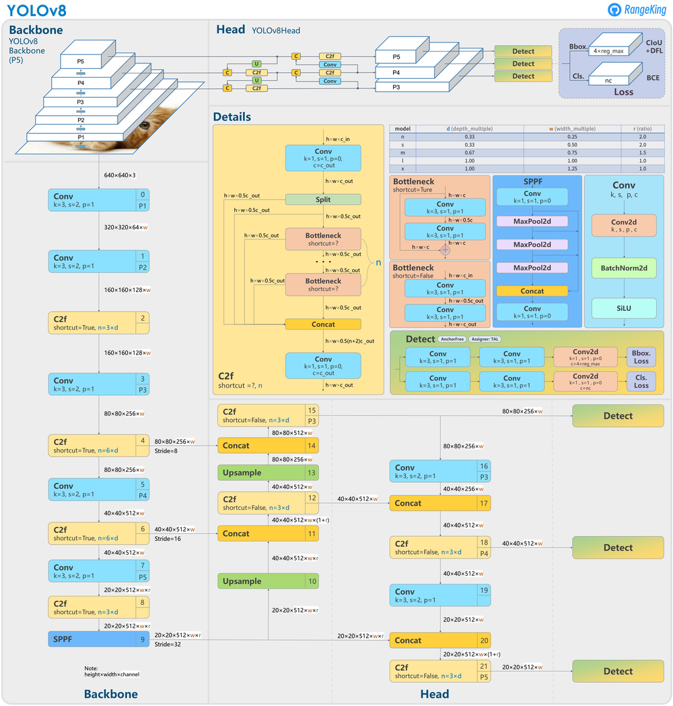
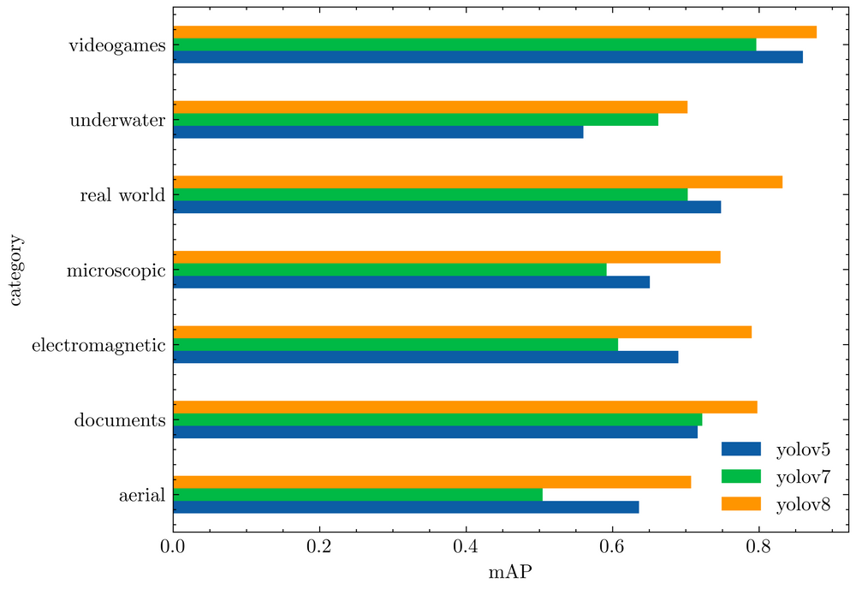
AI Model Description
★
Architecture of YoloV8
YoloV5/7/8 average mAP50
(RF100 Accuracy)
Notes:
And next, i will talk about our AI model description.
The core technology of our project is object recognition technology that recognizes facial expressions and behaviors of autistic children. We used the yolov8, a SOTA model, in the field of object recognition.
yolov8 was developed based on yolov5, and there were many improvements in architecture.
First of all, ultralytics improved yolo architectural structure from an anchor-based model to an anchor-free detection model, and also changed the composition of convolution.
n addition to improving the architecture, performance has also improved significantly compared to yolov5.
The graph on the right is a yolov5/7/8 performance comparison table evaluated through a benchmark called RF100 provided by roboflow. Each category shows various test cases such as underwater and micrographic, and in all cases, it can be seen that yolov8 performs better than other yolo groups.
해당 프로젝트의 핵심 기술은 자폐 아동들의 얼굴 표정 및 행동등을 인식하는 객체 인식 기술이다. 우리는 현재 객체 인식 분야에서 SOTA 모델인 yolov8 방식을 사용했다.
yolov8은 yolov5을 기반으로 만들어졌으며, 아키텍처 부분에서 많은 개선사항이 있었다.
우선, yolov8는 anchor-based model에서 anchor-free detection model로 아키텍처 구조를 개선하였고, convolution의 구성 또한 변경하였다.
아키텍처의 개선은 물론, yolov5에 비교해 성능 또한 높은 폭으로 개선되었다.
오른쪽 그래프는, roboflow에서 제공하는 RF100이라는 벤치마크를 통해 평가한 yolov5/7/8 성능비교표이다. 각 category는 underwater, microscopic등 다양한 test case를 나타내는데, 모든 경우에서 yolov8이 다른 yolo군보다 우수한 성능을 나타내는 것을 확인할 수 있다.

Slide 12
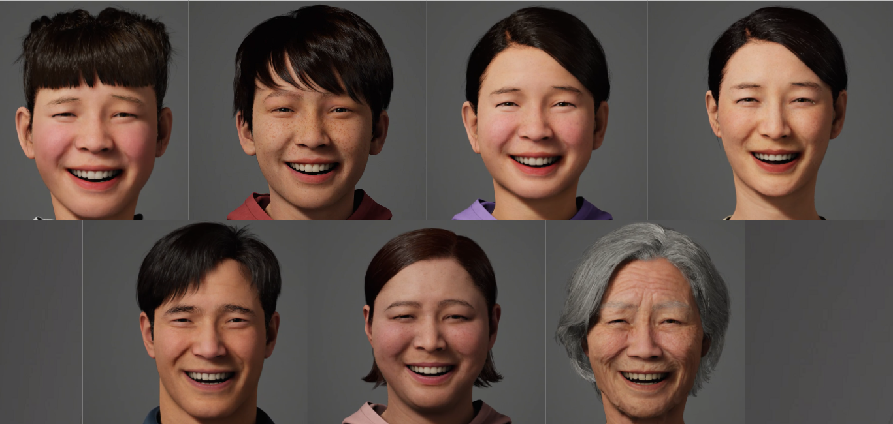
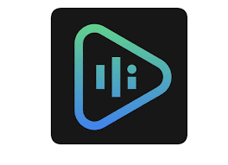
감정놀이방 Dataset
★
→ Meta Human Creator Dataset Was Used In 감정 놀이방
▷About 4879↑ Images of 5 Class ( Positive , Fear , Suppressed , Sad , Angry ) of 7 Person
▷Data Augmentation Work was also Carried Out during Training
→ Trained as YOLOv8 Model Over 100 epochs
→ Audio voice file describing the situation using Naver Clova dubbing
Clova Dubbing
Notes:
And next, i will tell you about our model dataset.
Our team used a tool called meta human creator provided by unreal engine to provide the appearance of the person. Most of the basic character sets provided by the meta human creator are Westerners, so we created virtual characters as similar to Asian extroverts as possible.
The dataset consists of five classes: positive, fear, suppressed, sad, and angry, but only five classes are currently used. There are about total of 4879 raw data sets in the emotional dataset, and augmentation work was carried out during model training through yolo.
And also Audio voice file describing the situation using Naver Clova dubbing was made to help users to know their emotion.

Slide 13
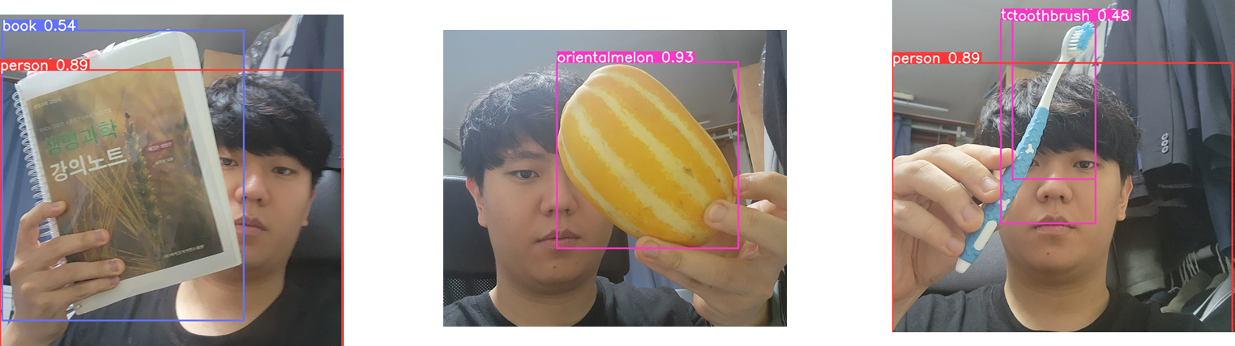
Coco Dataset
Converted Dataset on the Web to Coco type
Our Own Dataset Made by LabelImg
→ 1+2+3 DataSet Was Used In 행동 놀이방
▷About 40,000↑ Images of 20 Class (Fruits and Supplies)
→ Trained as YOLOv8 Model Over 150 epochs
행동놀이방 Dataset
★
Notes:
And We made our own dataset for “행동놀이방”. First we downloaded coco dataset for some classes. And we converted other types of dataset on the web to coco type. After combining them, we created and added some short-numbered datasets by using LabelImg program.
As a result, we used about 40,000 images of 20 classes, fruits and supplies, for 행동놀이방 dataset model training.

Slide 14
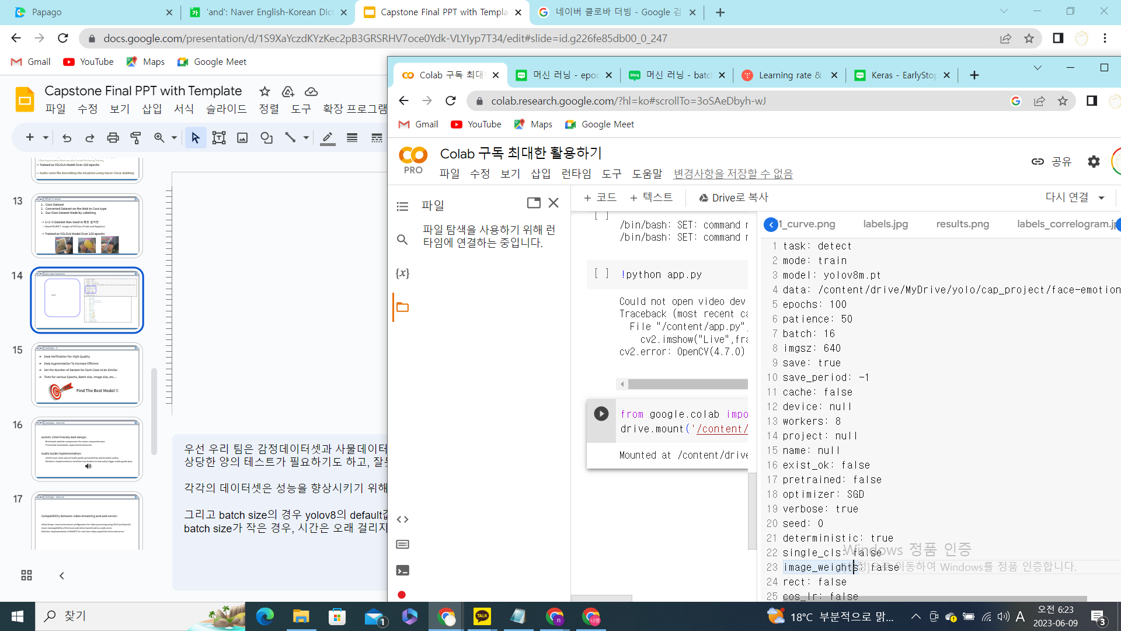
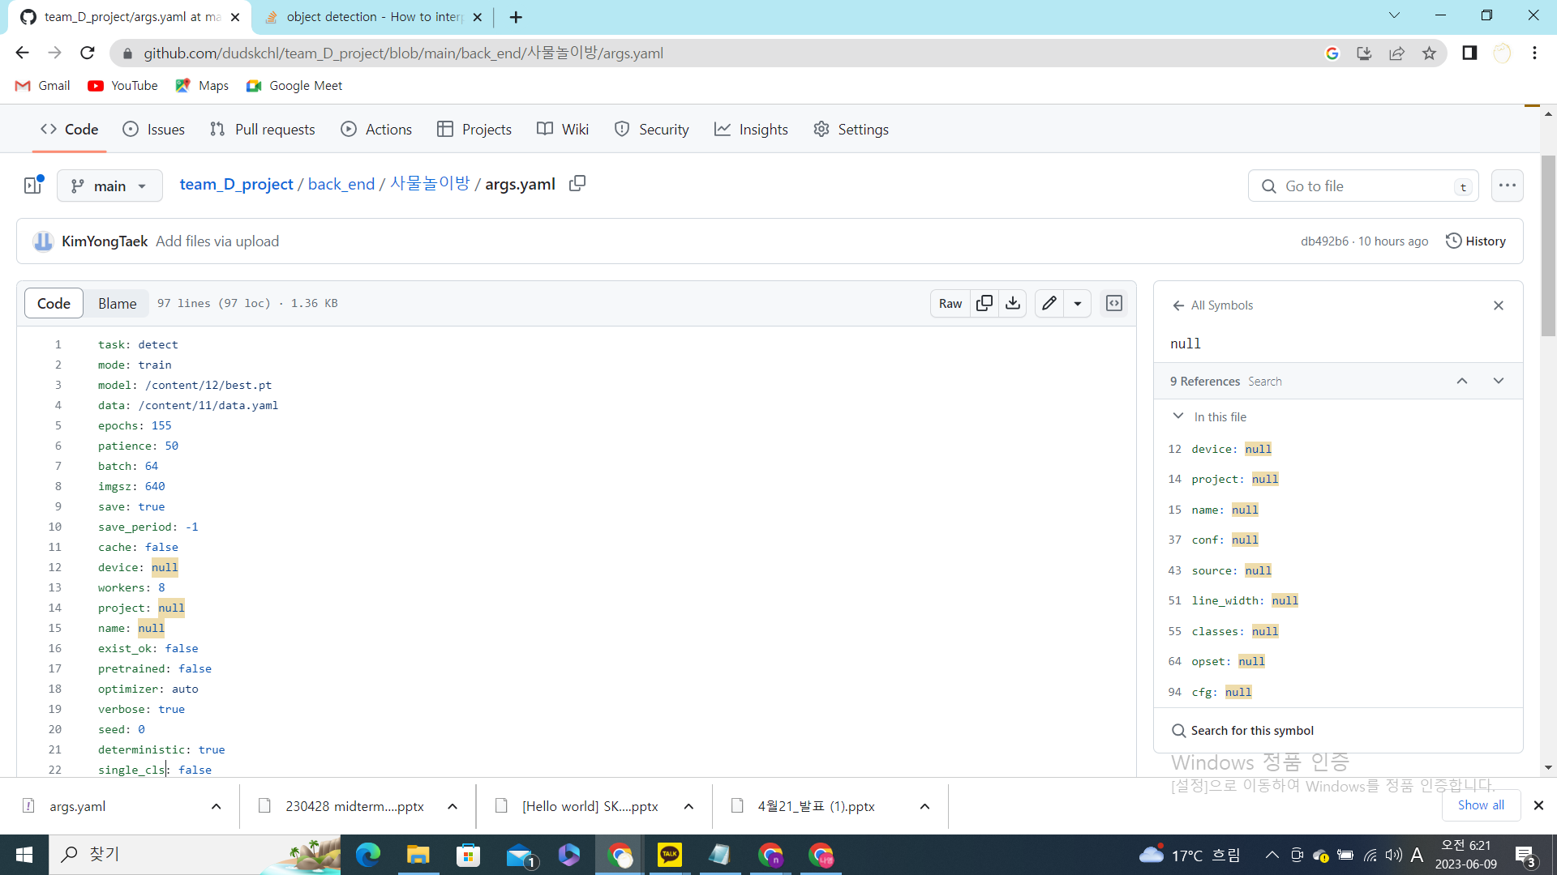
Main HyperParameters
★
epoch
batch size
optimizer
{emotion data model}
args.yaml
{object data model}
args.yaml
Notes:
The following is a description of hyperparameter settings.
First of all, our team did not perform hyperparameter tuning when training models. Tuning requires a considerable amount of testing to determine the optimal hyperparameters, and if it is wrong, overfitting occurs, so training was conducted with the default parameter value.
Each dataset was trained with epoch 100 for the emotional dataset model and epoch 155 for the object dataset model by adjusting the epoch value several times to improve performance.
And in the case of the batch size, the default value of yolov8 is 64, but in the case of the emotional dataset, the batch size was set low to 16 because it was necessary to distinguish fine differences in facial expressions.
If the batch size is small, it takes a long time, but because the variance of loss is relatively large, more diverse and sharp learning is possible.
And in the case of optimizer, the emotion dataset was set to SGD, which maintains a stable learning speed. The optimizer of the object dataset model is set to auto.
우선 우리 팀은 감정데이터셋과 사물데이터셋의 모델을 트레이닝 시킬 때, 특별히 하이퍼파라미터 튜닝을 진행하지는 않았다. 튜닝을 하려면 최적의 하이퍼파라미터를 결정하기 위해 상당한 양의 테스트가 필요하기도 하고, 잘못하면 오히려 과적합 현상이 발생하기 때문에, default parameter값으로 트레이닝을 진행하였다.
각각의 데이터셋은 성능을 향상시키기 위해, epoch값을 여러차례에 걸쳐 조정하여, 감정데이터셋 모델은 epoch 100, 사물데이터셋 모델은 epoch 155로 훈련되었다.
그리고 batch size의 경우 yolov8의 default값은 64이지만, 감정데이터셋의 경우 얼굴표정들의 미세한 차이를 구분해야 하기 때문에, batch size를 16으로 낮게 설정했다.
batch size가 작은 경우, 시간은 오래 걸리지만, loss의 분산이 비교적 크기 때문에, 조금 더 다양하고 예리한 학습이 가능하다.
그리고 optimizer의 경우 감정데이터셋은 안정적인 학습속도를 유지하는 SGD로 설정하였습니다. 사물데이터셋 모델의 optimizer는 auto로 설정했습니다.

Slide 15

Challenges - AI
★
Data Verification For High-Quality
Data Augmentation To Increase Efficient
Set the Number of Dataset for Each Class to be Similar
Tests for various Epochs, Batch size, Image size, etc…
Find The Best Model !!
Notes:
The most important challenge in the AI part is increasing accuracy of prediction of the model.
To improve the accuracy of the model, we did data verification and augmentation to improve the quality of the dataset.
And we set the number of raw-data for each class to be similar. Especially for the 감정놀이방 dataset, we collected dataset with various races.
Also we did a lot of tests for various epochs, batch size, image size to find the best model.

Slide 16

Challenges - Front-End
★
Autistic Child-friendly Web Design:
Minimized website components for easier comprehension
Prioritized immediate, experiential elements
Audio Guide Implementation:
Initial issue: Auto-play of audio guide prevented by web browser policy
Solution: Implemented an intuitive icon button to manually trigger audio guide play
Notes:
In the process of front-end development of this project, the greatest challenge was considering a autistic child-friendly web design.
We tried to minimize the components of the website to make it easier for users with autism to understand.
Also, we attempted to add an audio guide to aid the users' understanding, but we encountered an issue where the audio file would not automatically play due to web browser policy.
To resolve this, we designed a separate, easily understood icon button which only triggers the audio file to play when clicked.

Slide 17
Challenges - Back-End
★
Compatibility between video streaming and web server:
Initial Setup: Local environment configuration for video processing using YOLO and OpenCV
Issue: Incompatibility of the local code when transferred to a web server
Solution: Implementation of WebRTC for real-time video acquisition from web server
Notes:
The most significant challenge in backend development was handling video streaming and making the app functional on a web server.
Initially, we set up a local environment to process videos using YOLO and OpenCV.
However, when we tried to run this app on a web server, the local code was not compatible, requiring us to find an alternative.
After several attempts, we employed WebRTC, enabling us to obtain videos directly from the web server in real time.

Slide 18
Limitation - AI
★
“감정 놀이방” | Neutral and Normal emotions was Deleted ▷ In the case of emotions without a clear characteristic difference, it was not well distinguished. Most of the raw data are Western images ▷ Performance may be slightly lower than expected results because of the ratio of Asian images Raw data mainly focuses on Adult images ▷ The users of our project are mainly autistic patients from childhood to adolescence, But it recognizes Children's Facial emotions, So the Performance is Lower than expected.
“행동 놀이방” | 1. The Accuracy didn't come out as high as we expected ▷ There is a limit to getting a High-Definition and High-Quality Dataset for 20 classes ▷ YOLO is not good at detecting Small Object ( Shortcoming of YOLO ) ▷ So Model often cannot recognize Some Classes of Object according to the Angle
Notes:
Next is limitations about AI model.
For the “감정놀이방” Dataset,
We deleted Neutral and Normal emotions. In the case of emotions without a clear characteristic difference, it was not well distinguished, so that emotion class was deleted.
Second, since most of the raw data are Western images, the performance may be slightly lower than expected results because the ratio of Asian images has been trained significantly less.
And, The users of our project are mainly autistic patients from childhood to adolescence, and raw data mainly focuses on adult images, so it recognizes children's facial emotions, and the performance is bound to be lower than expected.
For the “행동놀이방” Dataset,
The Accuracy didn't come out as high as we expected.
Because there is a limit to getting a High-Definition and High-Quality Dataset for 20 classes.
Also, YOLO is not good at detecting Small Object. This is Shortcoming of YOLO.
So Model often cannot recognize just Some Classes of Object according to the Angle.

Slide 19
Limitation - Web
★
Functionality dependency on web browser
Real-time video streaming can be vulnerable to network
Security and privacy issue
These factors can affect the user experience in negative way
Notes:
There are also some limitations regarding web.
First, not all web browsers offer the same functionality, affecting the user experience.
Second, real time video streaming can be vulnerable to network problems such as bandwidth and latency. And this can lead to reduced video quality.
Lastly, this application imposes important considerations for security and privacy. this information should be properly protected because users share personal data through the webcam.
All these factors can affect the user experience in negative way.

Slide 20
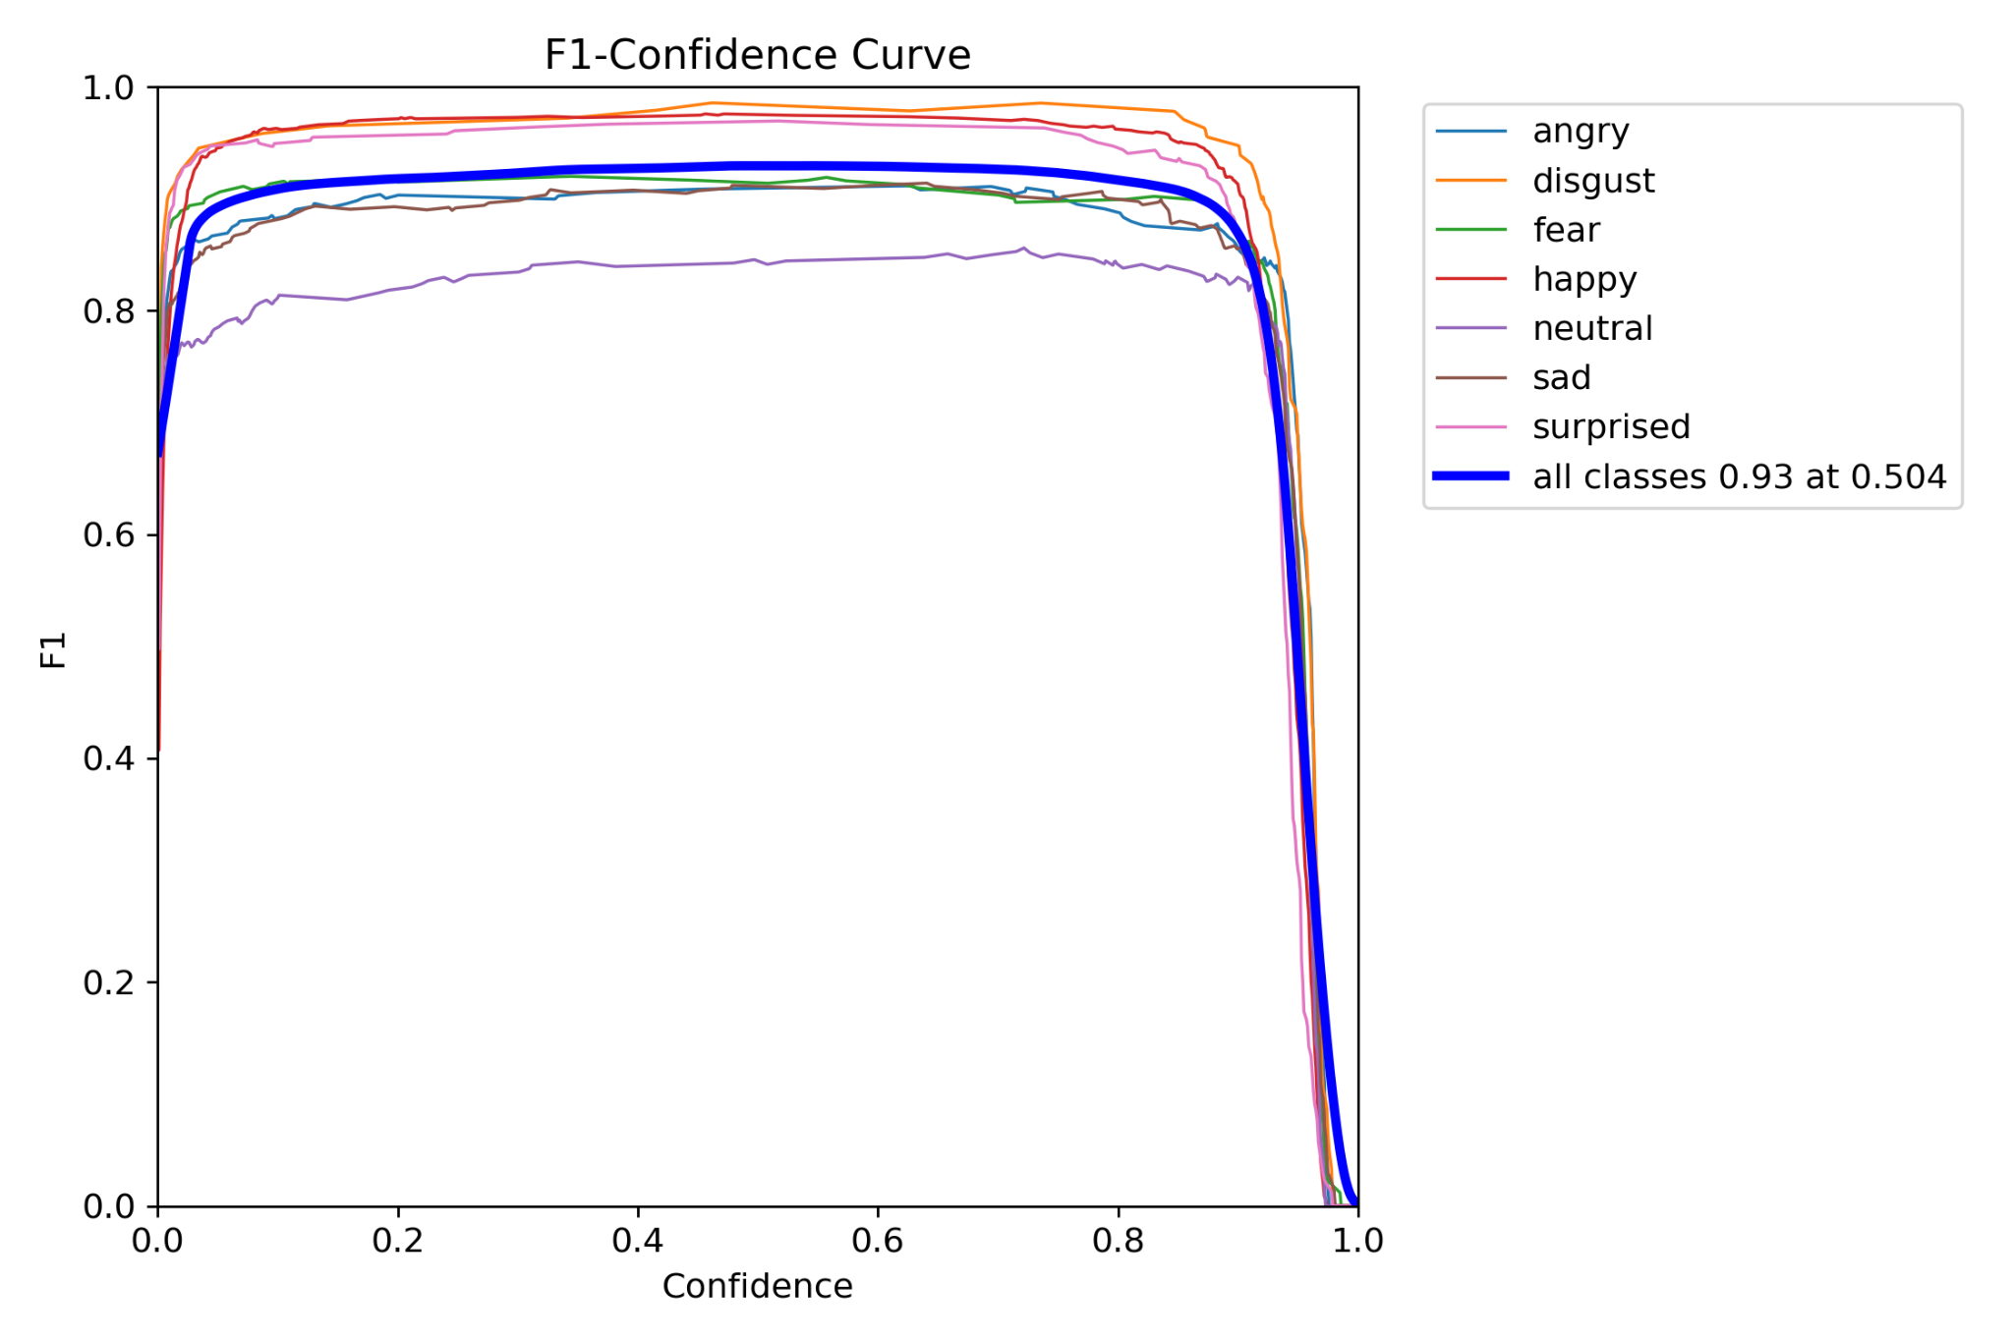
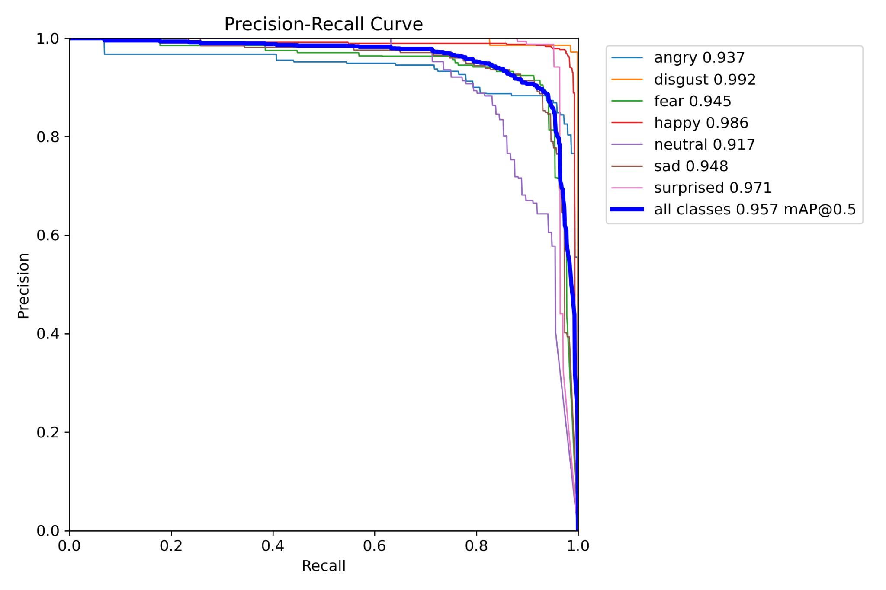
Evaluation
★
< 감정 놀이방 >
Notes:
As performance evaluation items for AI models, F1 Score, Precision-Recall, and mAP-0.5 were used.
Precision can be calculated by using the ratio of the correct answers among the predictions of positive. And recall can be calculated by using the ratio of finding the real one out of the actual positives model have.
And F1 score is a harmonized mean of Precision and Recall. mAP, mean average precision, means the ratio of the overlap of the ground truth and prediction. So, if mAP is bigger than 50%, consider it as a correct prediction.
You can see actual operating test in demo video. And, this is evaluation graph of 감정 놀이방.
For “감정놀이방” AI model, we did 100 epochs training with 16 batch size. We got 93% F1 score(at 0.504 confidence), and 95% mAP-50 score.

Slide 21
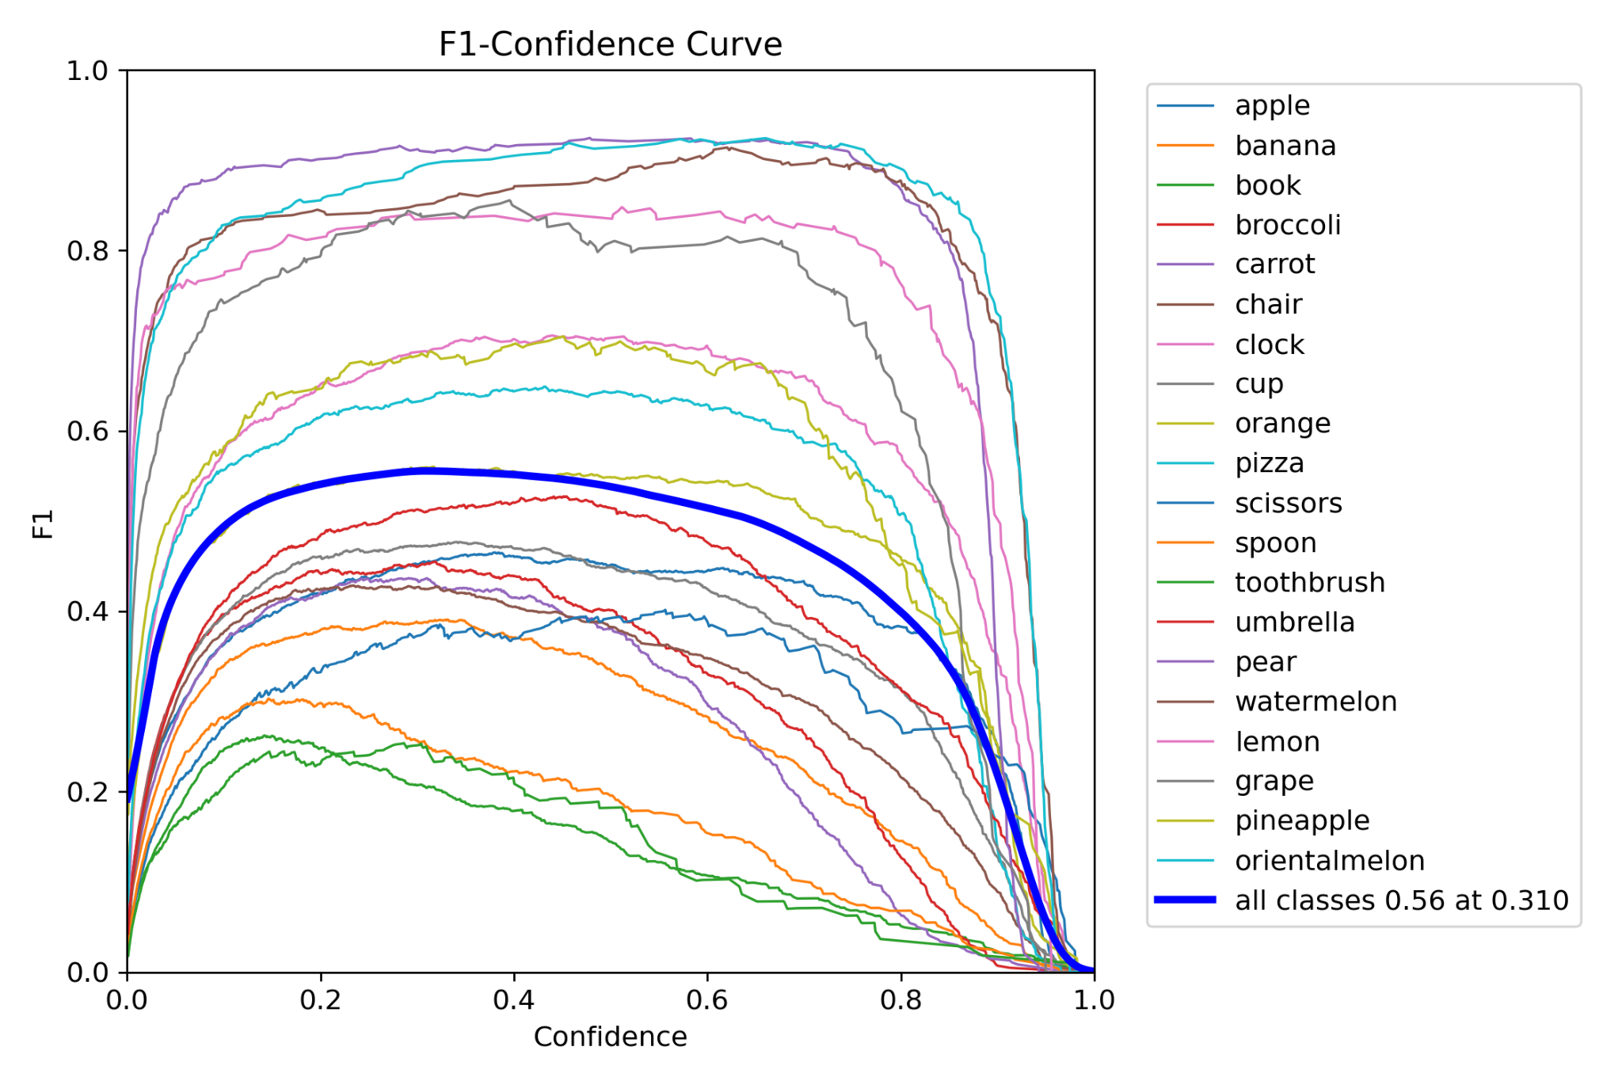
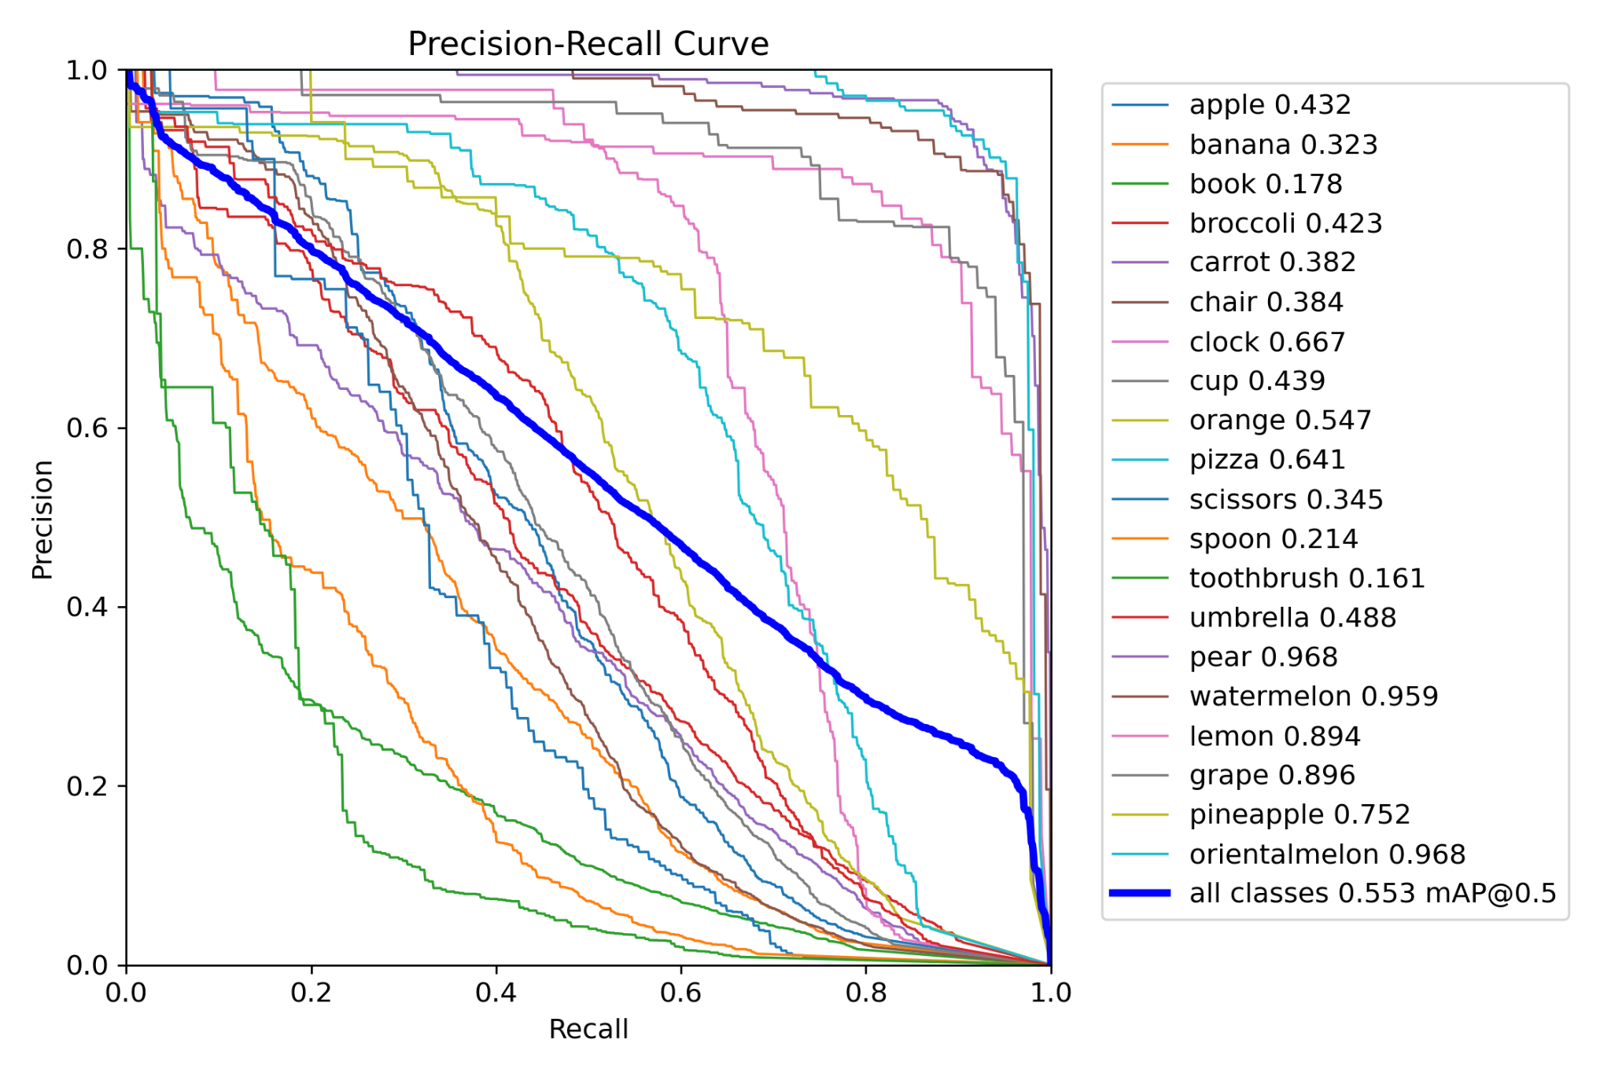
Evaluation
★
< 행동 놀이방 >
Notes:
And this is graph of 행동 놀이방.
For “행동놀이방” AI model, we did 150 epochs training with 64 batch size and 640 pixel image size. We got 56% F1 score, and 56% mAP-50 score.

Slide 22
Thank You!
Final Presentation
★
Notes:
This is the end of our presentation.
Thank you for listening.

